Slide 1
Lightning Talk: Ethics and Professional Responsibility
sdmay25-40

Slide 2
Project Overview
Our project is a novel view synthesis system that renders 3D Gaussian splats via ray tracing to allow for dynamic relighting and triangle meshes integration.
A Machine Learning (ML) model is used to extract material and lighting properties from videos.
User friendly Unity package we be made, consisting of our renderer and ML model.

Slide 3
Project Overview - Novel View Synthesis
Novel View Synthesis: A technique used to generate images from any perspective.
Traditional Methods: Neural Radiance Fields (NeRFS)
Drawbacks of NERFS:
Expensive
Produce subpar results
New Solution: 3D Gaussian Splatting
Faster to compute
Provides higher quality results
Drawbacks of New Solution:
Not relightable
Proposed Solution for Limitation:
Use ML to extract the model's lighting and material properties.

Slide 4
Project Overview - 3D Gaussian
To be able to create models we use 3D Gaussians.
Think of a 3D Gaussian as a blurry dot in space.
By combining and reshaping multiple 3D Gaussians we can build 3D objects.
3D Gaussians can have multiple different variables including position, color, opacity, and covariance.

Slide 5
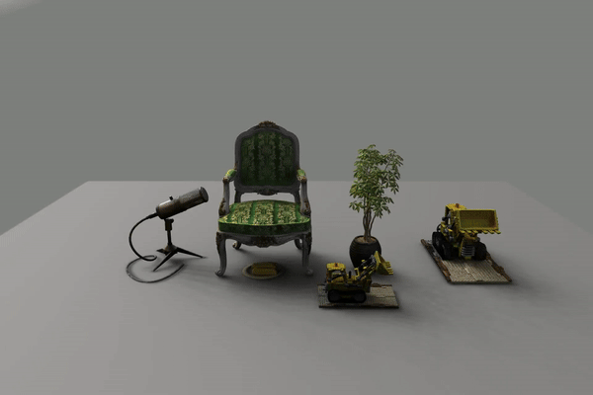
Project Overview - Relightability
Relightability is the technique of removing the original lighting from a model to instead insert our own.
Allows for us to change the lighting in a few different ways like changing the intensity and position of the lights.
The 3D Gaussians are able to be relightable because of the variables of the Gaussians like color, and roughness that act as material properties.
Source: https://nju-3dv.github.io/projects/Relightable3DGaussian/

Slide 6
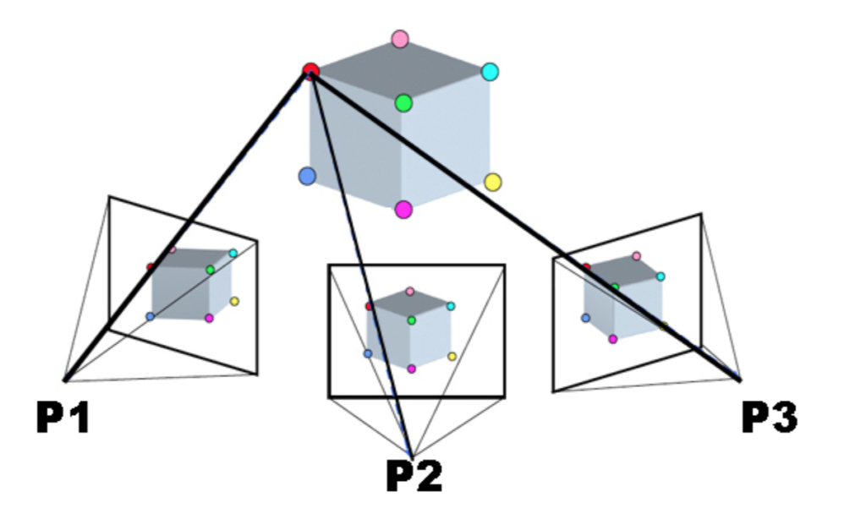
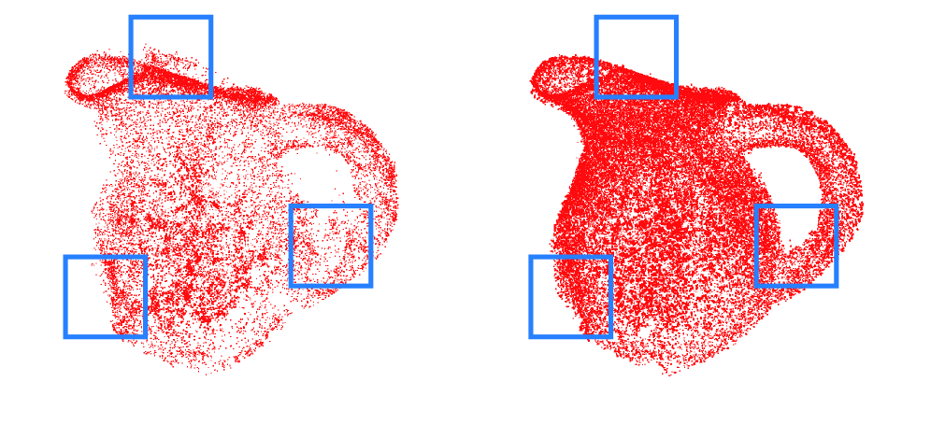
Project Overview - ML Applications
Structure from Motion (SfM)
Reconstructs 3D structures from multiple 2D images.
Gaussian Point Optimizer
Position, opacity, covariance, color.
Material predictor
Reflectivity, roughness, and transparency.

Slide 7
Work Competence
Our project requires the combination of several advanced topics including graphics programming on the GPU and training machine learning models
In order to successfully work with these advanced topics we all need to continuously learn and practice with them.
Every member of the team has made sure to be curious about the technology involved in our project and has practiced with it.
These steps are making our teams effective and competent while working on our project.

Slide 8
Sustainability
Our project makes use of machine learning models and AI. AI can be very energy intensive which can be harmful for the environment.
So far we have only discussed the issue of the environmental impact of our project in passing and haven’t done formal research,
In the future we are going to do in depth research of how the models we are using affect the environment and make sure we are minimizing the impact they have.

Slide 9
Broader Context Area-Four Principles Chart
 | Beneficence | Nonmaleficence | Respect for Autonomy | Justice
Public health, safety, and welfare | Our system will directly benefit our users and stakeholders by offering a faster, higher quality, more flexible solution to the current industry standard for Novel View Synthesis | Our system does directly or indirectly harm our stakeholders and users | After creating a minimum viable product, we plan to send out prototypes to stakeholders and receive user feedback before the system is finalized | Our system will be neatly contained in a Unity Package and will be freely available to download on the Unity Asset Store
Global, cultural, and social | Our system is advancing the research of computer graphics and machine learning industries and its mainstream adoption | Our system does not go against or disrespects any particular culture or social group | Our system could support cultural practice by digitally capturing one-to-one recreations of culturally significant locations (e.g., religious sites) | Our system will remain culturally accessible by offering a visual demonstration on how to use our system
Environmental | Our system captures the beauty of real world environments which may inspire users to be more environmentally conscious | Even though our system uses machine learning, our model’s training is not computationally expensive when compared to LLMs | Our system does not require the user to re-train the relightable Gaussian model locally | Our system will not affect any environmental habitat
Economic | Our system increases the production quality of renders for smaller companies therefore creating more competition | We mitigate any potential 3D artist job loss by allowing full support of industry standard tooling | We will make our product free of charge | Our system will not financially affect our users

Slide 10
What Potential Ethical Issues Are You Uncertain or Concerned About Related to Your Project?
Displacement of 3D Modeling Artists
Our system will be capable of recreating better-looking real world environments almost instantaneously compared to an artist
Deep Fakes
Our system could be used to create fake hyper-realistic environments, making it challenging to distinguish between a photograph and our rendered image

Slide 11
Conclusion
Positive Impact
Advances new compute graphics and machine learning research
Enhanced visuals and performance
Accessible
Ethical Concerns
Potential displacement of 3D modeling artists
Misuse of system for deep fake media

